Slide 1
Automated Customer Reviews with Natural Language Processing
Diego Rosa Paz
Sylvia Y. Pérez Montero

Slide 2
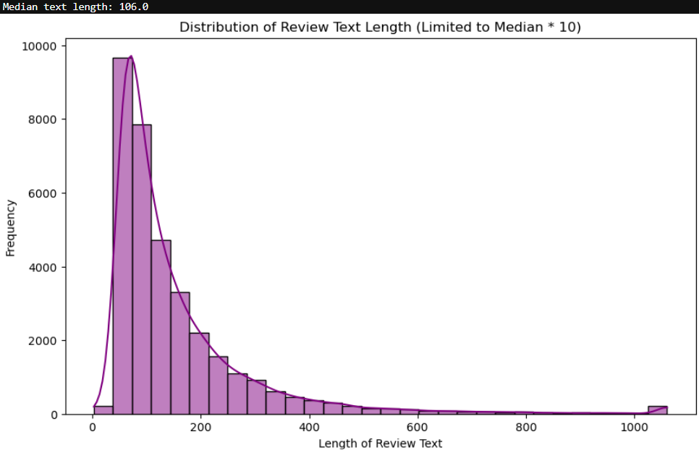
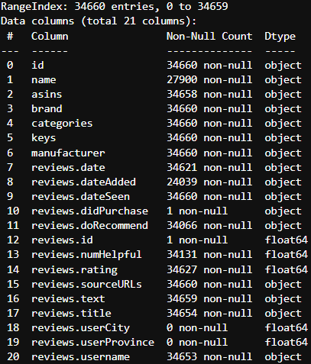
Consumer Reviews of Amazon Products

Slide 3
NLP Modeling
Phase I (Traditional Models)
Naïve Bayes, Logistic Regression, Random Forest and Support Vector models were generated and trained.
Optimization steps generally worsened the models’ performance.
Undersampling was looked at to balance out the impact of the lower ratings (1,2,3) being so underrepresented.
Phase II – Deep Learning Model (BERT / DistilBERT)
Results were much more positive than previous models.

Slide 4
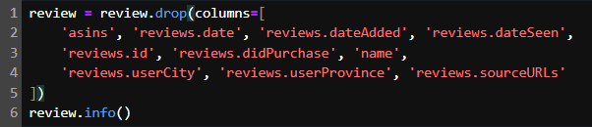
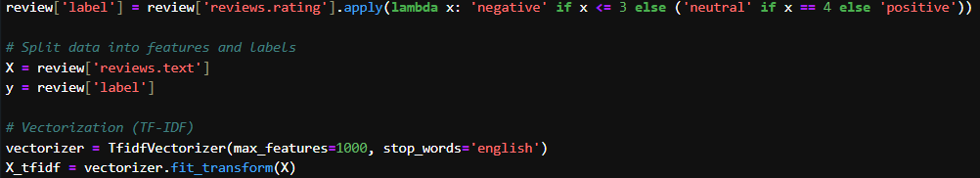
👩‍🌾 Traditional Machine Learning Models 🧑‍🌾
After removing half the columns in the dataset, we applied TF-IDF vectorization to the ‘reviews.text’ column, aiming to predict and label if a rating would be negative, neutral or positive off of the reviews left by customers. For this approach we got out best results with Random Forest Classifiers and Support Vector Classifiers.

Slide 5
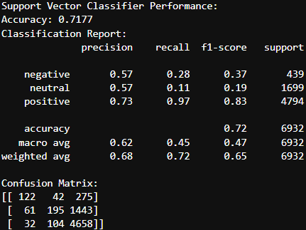
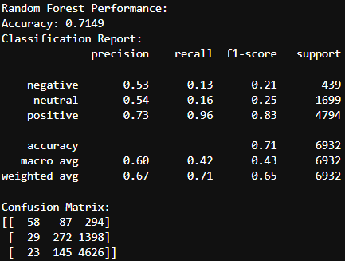
👩‍🌾 Traditional Results🧑‍🌾

Slide 6
Results (“Optimized” traditional models + DistilBERT)
Model | Model Accuracy | F1 Score | Precision | Recall
DistilBERT | 93.37% | 90.17% | 87.18% | 93.37%
Support Vector (TF-IDF) | 71.77% | 83.00% | 73.00% | 97.00%
Random Forest (TF-IDF) | 71.61% | 83.00% | 73.00% | 97.00%
Naïve Bayes (TF-IDF) | 11.90% | 9.00% | 22.00% | 18.00%
Naïve Bayes (Count) | 11.90% | 9.00% | 22.00% | 18.00%
Logistic Regression (TF-IDF) | 6.19% | 5.00% | 21.00% | 16.00%
Logistic Regression (Count) | 6.19% | 5.00% | 21.00% | 16.00%

Slide 7
Summary
DistilBERT had significantly better results than the traditional Naïve Bayes, Logistic Regression, and Random Forest models.
Accuracy of 93.37% was dramatically higher
F1-Score of 90.17% suggests a strong balance between precision and recall, whereas the traditional models had very low values
Precision (87.18%) and recall (93.37%) show that DistilBERT predicts very well and also captures most relevant cases.
While the traditional models struggled with class imbalance (even with tuning), DistilBERT appears to generalize well
Within the ML models, Random Forest outperformed Naïve Bayes and Logistic Regression
Still much lower accuracy than DistilBERT
Optimization Recommendations:
Increase training epochs for DistilBERT (5-10 versus the 3 used here)
Hyperparameter tuning:
Batch size (8 ->16)
Learning rate
Max length of sequences (256 -> 512)
Look further into adjusting class weights, particularly of the 1 and 2 ratings.
Combine DistilBERT with other Transformers

